Slide 1
Java-Selenium Basic to Advanced Training
-Priyanka Nigade

Slide 2
About trainer
15 years experience.
ISTQB Certified
Full time software testing manual & automation trainer.
Conducted trainings for multiple corporates.
Trained 5000+ professionals.
You tube channel “Automation With Priyanka”.

Slide 3

Training Flow
Fameworks
TestNG,Cucumber,Maven
Selenium WebDriver
Java Programming Overview
Selenium Introduction
Basics of Automation Testing

Slide 4
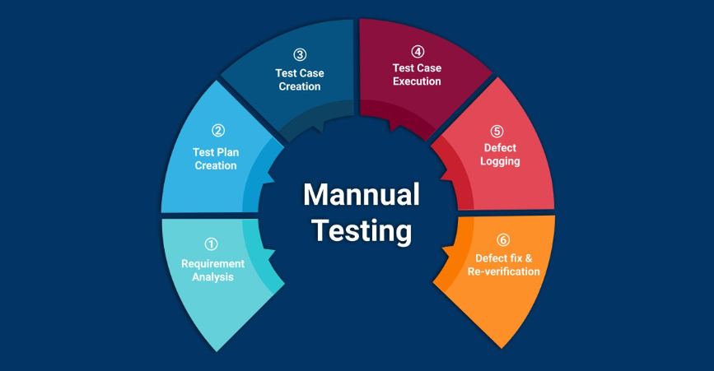
Prerequisite for Training

Slide 5
Automation Basics

Slide 6
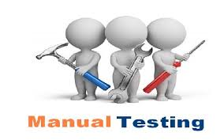
Manual testing
Manual testing is process of manually testing software application with the intension of finding defects.

Slide 7
When is Manual Testing Good Idea?
Subjective Validation
New/Changing Functionality
Strategic Development
Complex Functionality

Slide 8

Manual Testing Challenges
Manual testing is traditional form of testing.
Repetitive
Coverage
Reliable
Reusable
Require more resource
Speed
Costly
More time & efforts

Slide 9

Automation testing
Automation testing is process of testing software application with the help of tool to find out defects from the application.

Slide 10
Need For Automation Testing
Every organization has unique reasons for automating software quality activities, but several reasons common across industries
Speed (fast to execute but except initial time)
Reliable
Repeatable
Saves time
Coverage
Reusable
Cost effective
programmable

Slide 11
When To Automate Application?
Requirements do not change frequently.
Projects that need to test the same areas often.
All manual testing process in place as per expected results and tested twice manually.

Slide 12
Types Of Automation Tests
Functional Automated Tests
Non Functional Automated Tests

Slide 13
Selection Of Automation Tools
First, Identify the requirements, explore various tools and its capabilities, set the expectation from the tool and go for a Proof Of Concept.
Tool should be compatible as per checklist.
Easy to learn and technical support should be available.

Slide 14
What is selenium…
Selenium is an open source Browser based test Automation.
Selenium is a suite of tools to automate web application testing
Works by simulating users action such as mouse click and key pressed.
Works anywhere JavaScript is supported.
Runs in many browser and operating systems.(IE, MozillaFirefox, Safari, Google Chrome and Opera…/Windows, Linux, Mac..)
Can be controlled by many programming languages and testing frameworks.
(HTML,PHP,C#,Java,Ruby,Python..etc.)

Slide 15
Selenium Phases
Selenium 4
Selenium 3
Selenium2
Selenium 1

Slide 16
Selenium Benefits
Open Source
Cross platform
Cross browser support
Remote execution
Parallel execution
Integration with multiple tools
And many more

Slide 17
Limitations
Can not automate windows applications
We can not read images
Bar code, Graphs, pie charts, OTP can not be automated

Slide 18
We can use Selenium
Functional testing
Smoke test scenario
Regression test
End to End Scenario

Slide 19
Selenium components
Selnium IDE
Selenium Rc(deprecated)
Selenium WebDriver
Selenium grid

